Slide 1
Artificial Intelligence in Fashion

Slide 2
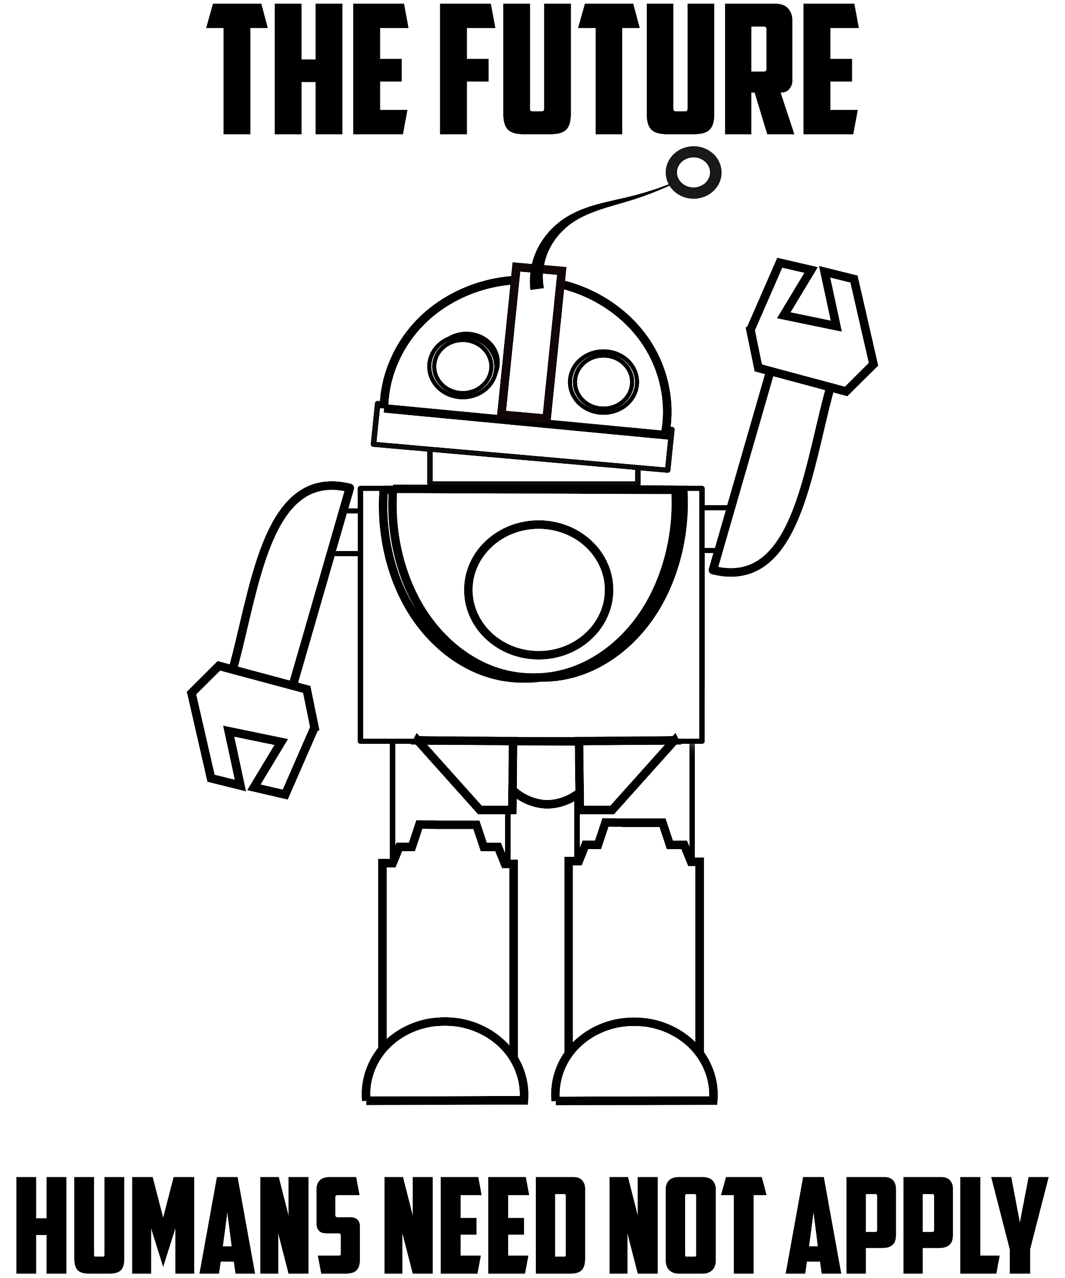
What is it?
Machine learning / AI is a field of computer science that uses statistical techniques to give computer systems the ability to "learn" with data, without being explicitly programmed. - Arthur Samuel 1959
Evolved from general AI, Computation Statistics, and Mathematical Optimization
Used heavily by Data Scientists

Slide 3
What is it?
Machine learning / AI is a field of computer science that uses statistical techniques to give computer systems the ability to "learn" with data, without being explicitly programmed. - Arthur Samuel 1959
Evolved from general AI, Computation Statistics, and Mathematical Optimization
Used heavily by Data Scientists

Slide 4

So who is a Data Scientist?
If Data Science is the future … we need you to understand AI and be part of the field
You!

Slide 5
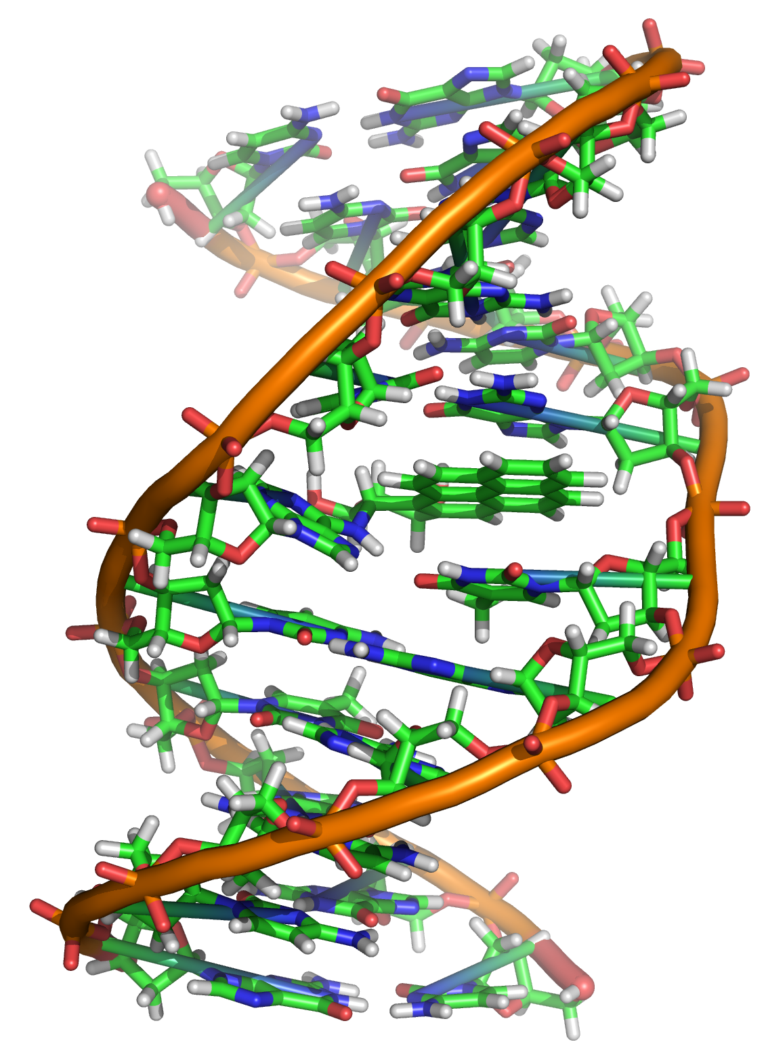
Biology

Slide 6
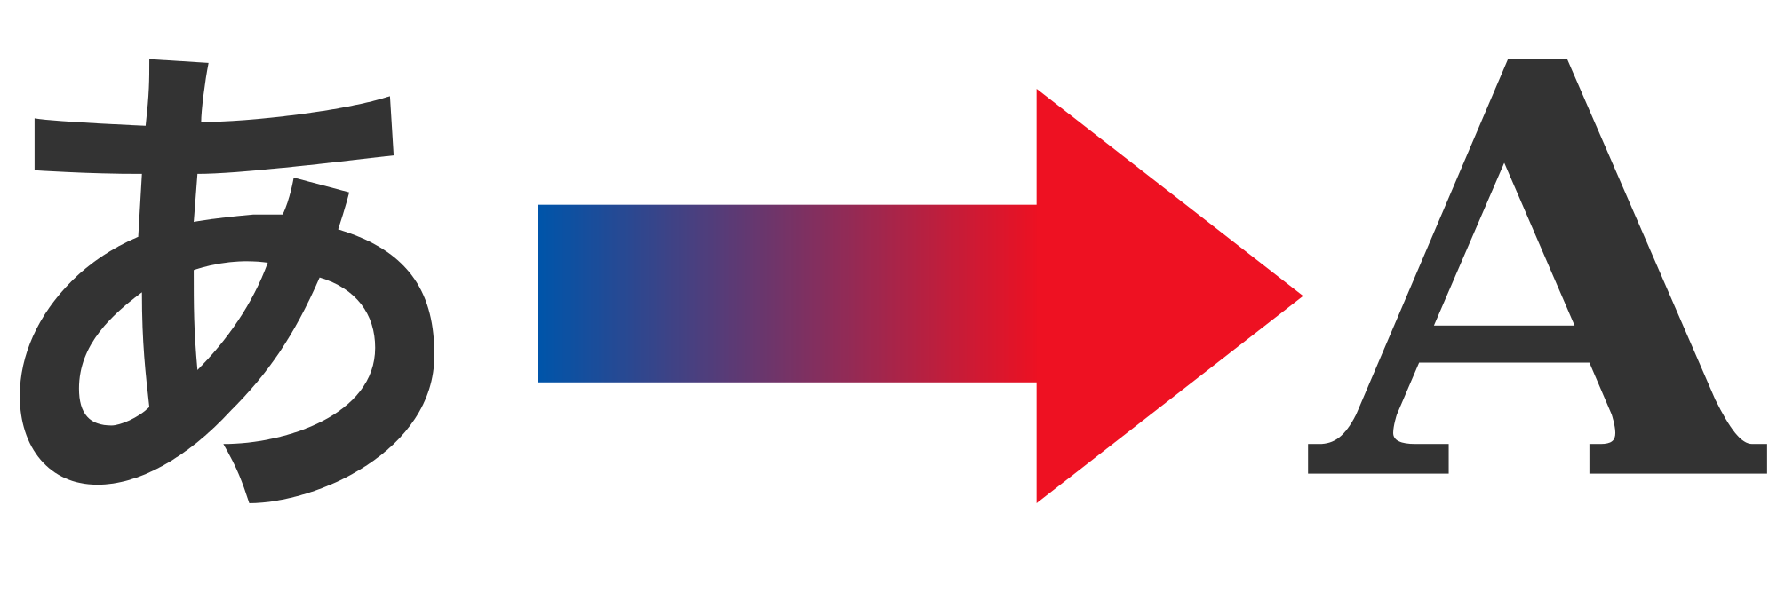
Linguistics

Slide 7
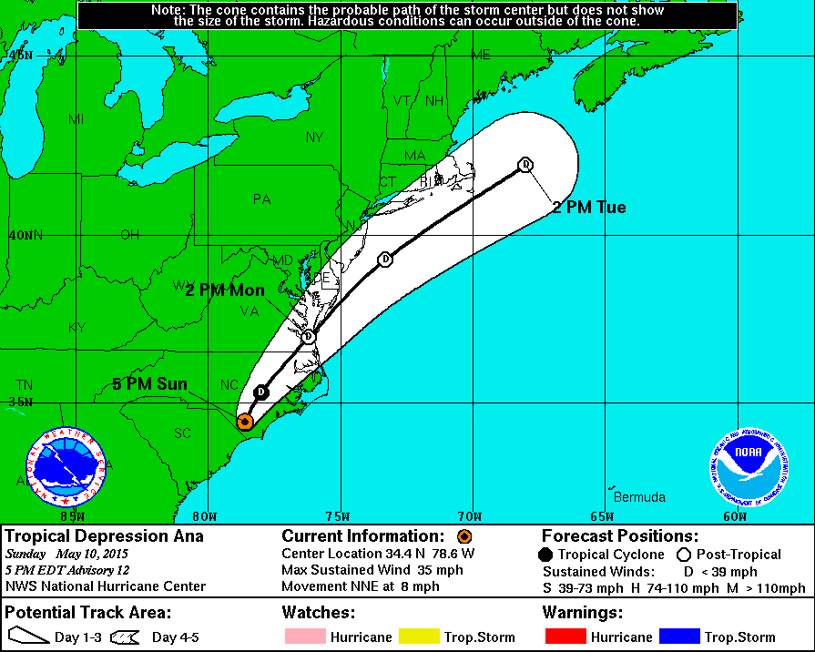
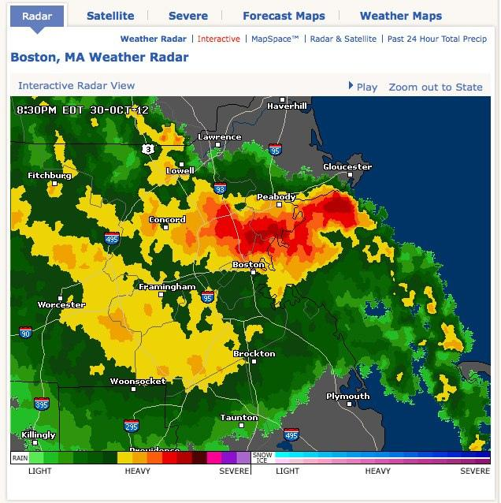
Meteorology

Slide 8
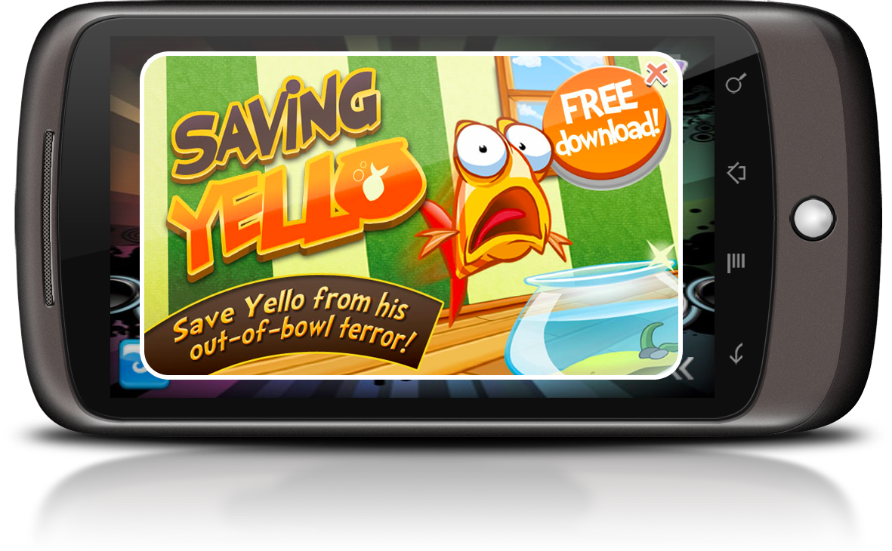
Business

Slide 9
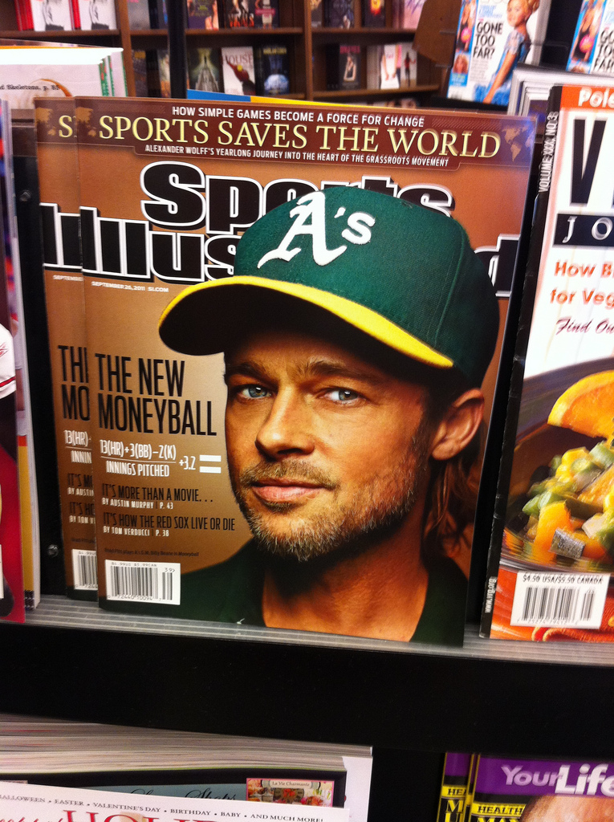
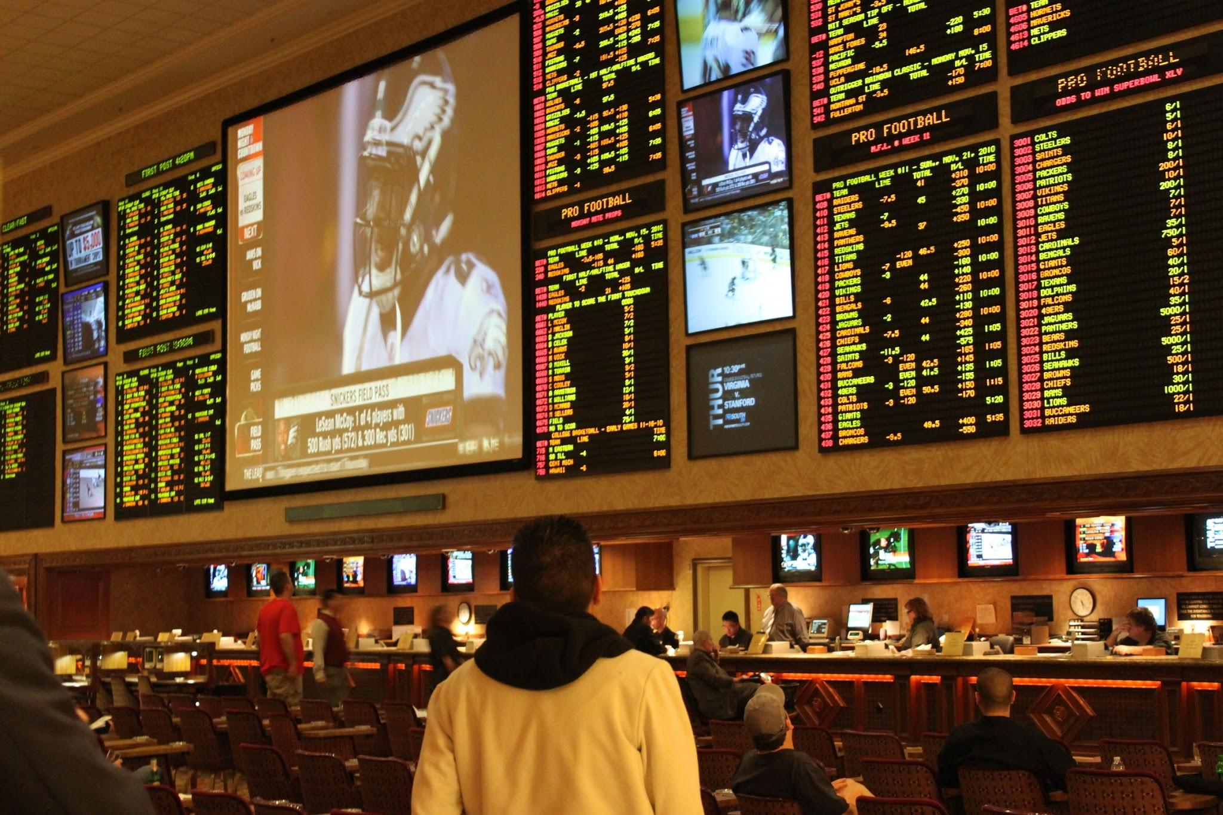
Sports

Slide 10
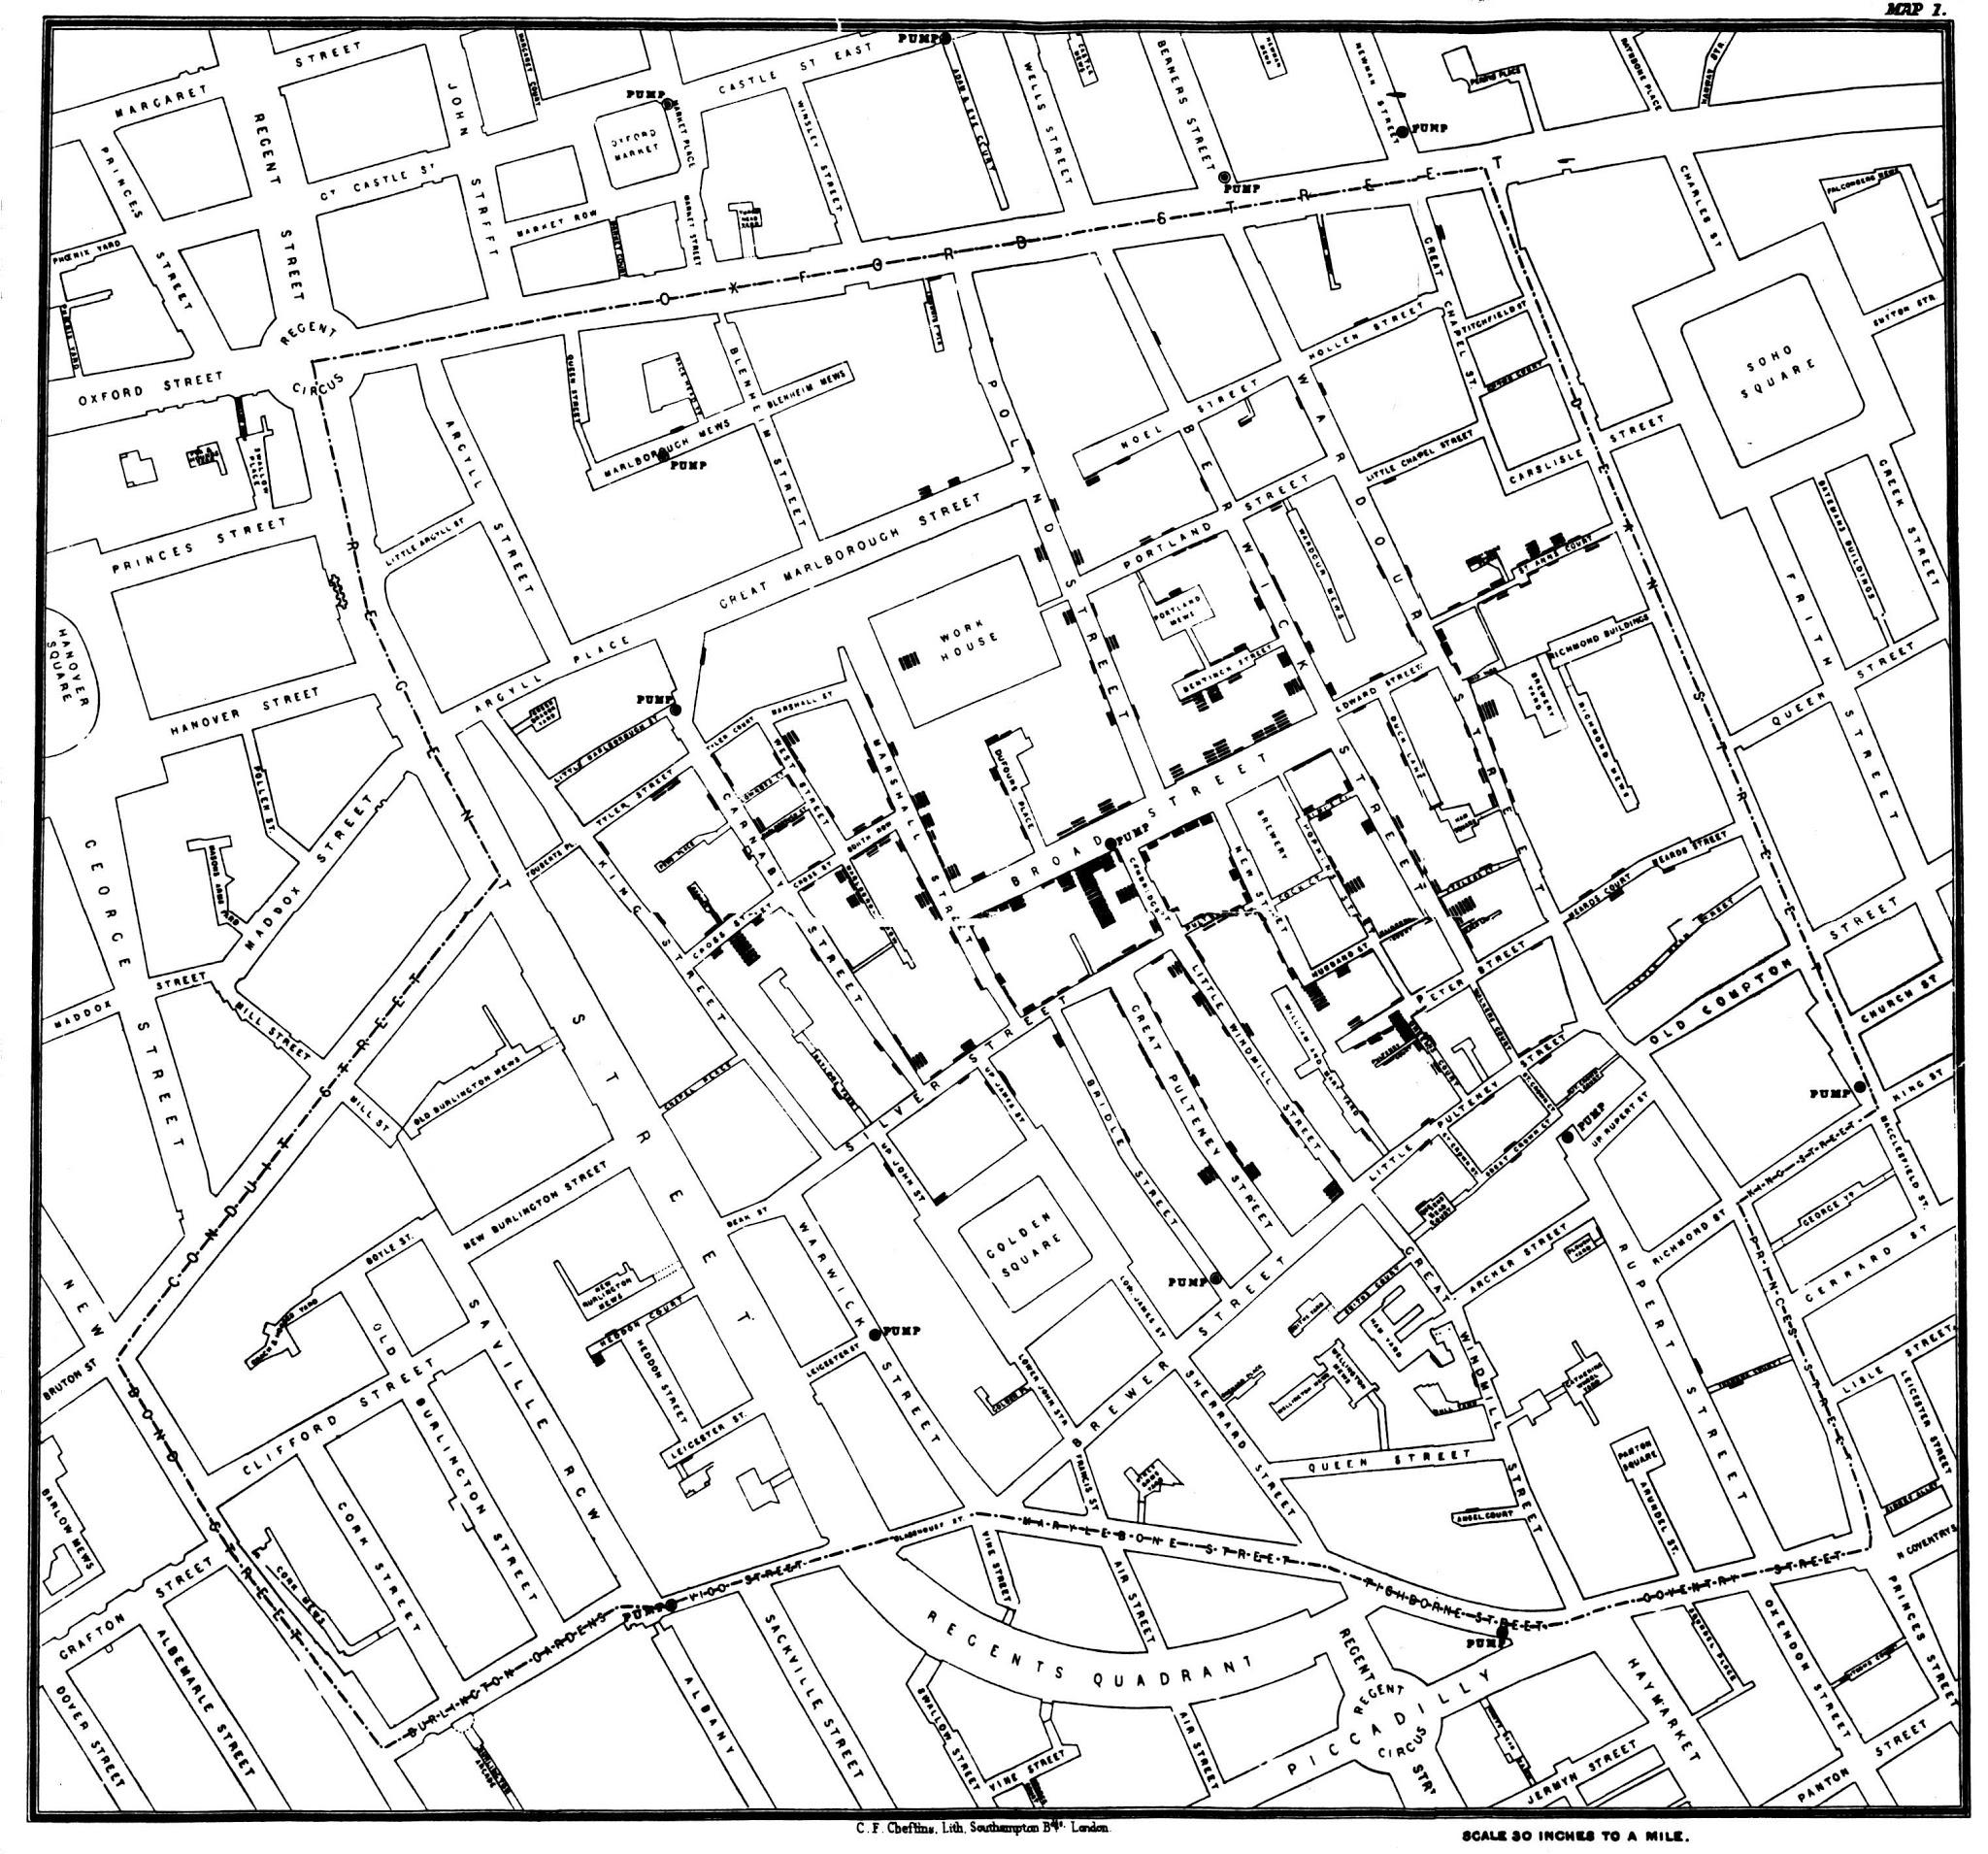
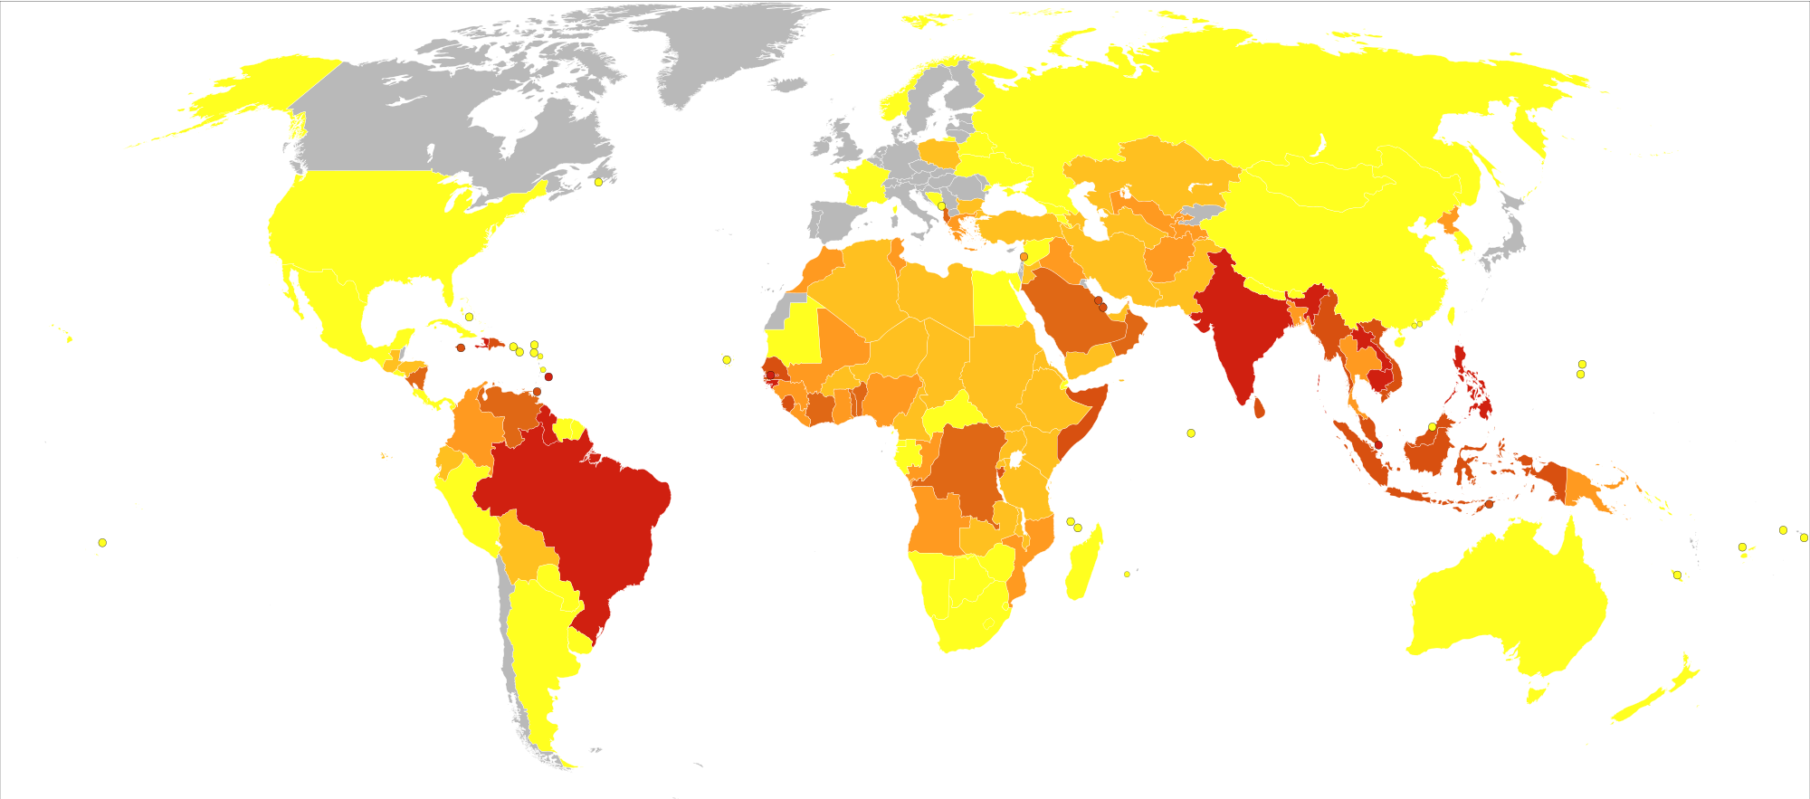
Epidemiology

Slide 11
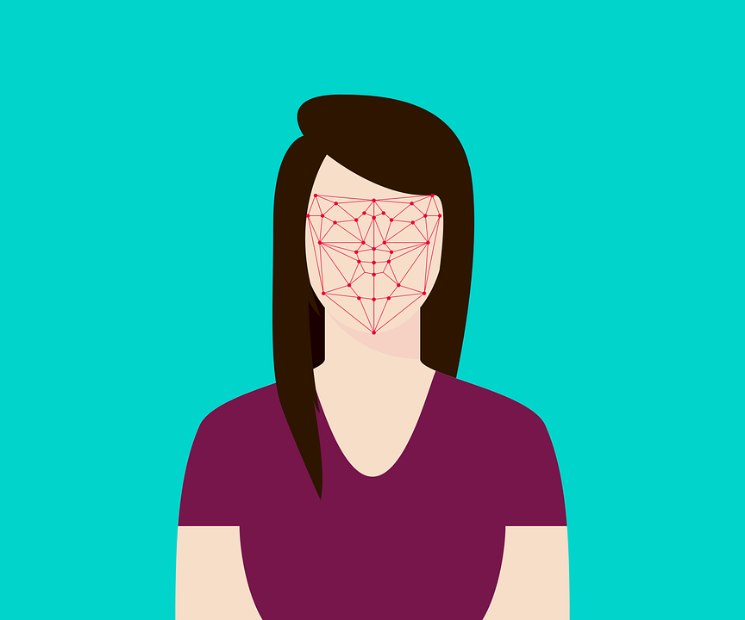
Security

Slide 12
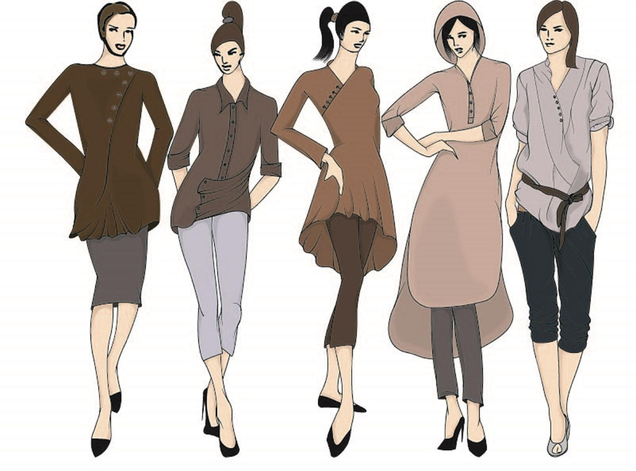
Fashion!
What domain knowledge do you bring to the future?
Take a few minutes in groups and brainstorm a few possibilities
What do you know that you think would be helpful for a Compute to know?
Do you know something that a Computer cannot understand?

Slide 13
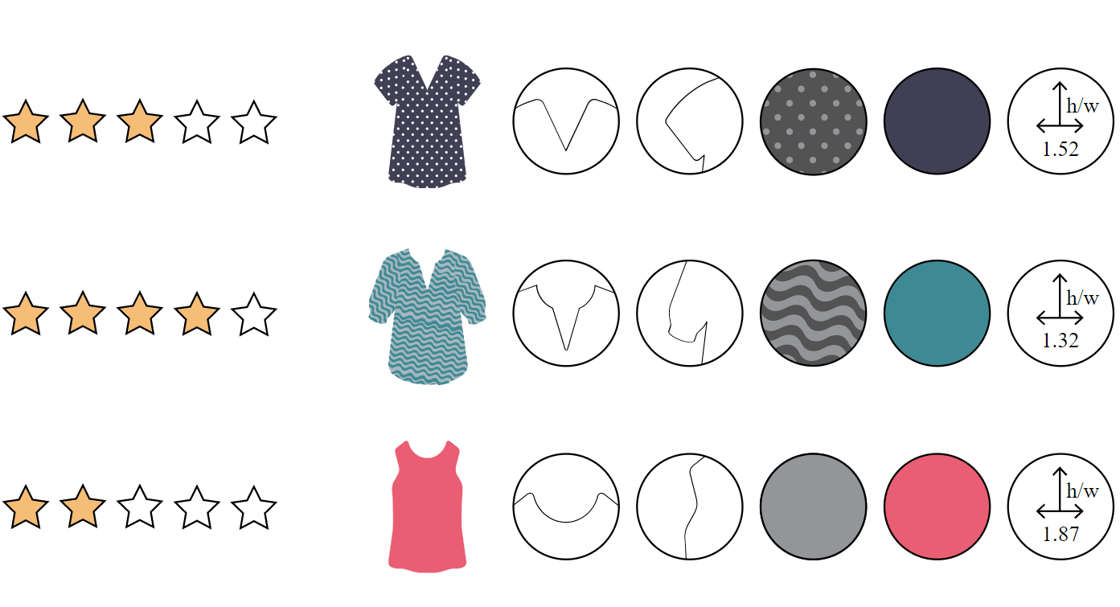
Existing examples (Stitch Fix)

Slide 14
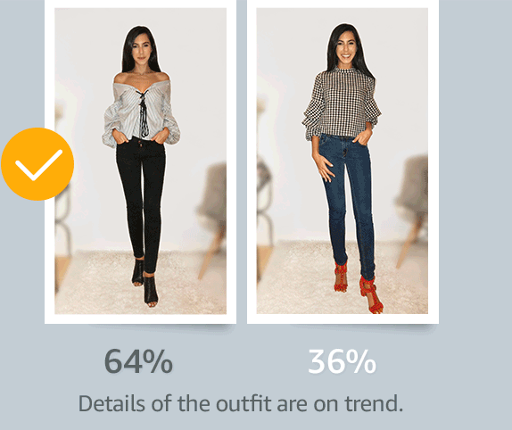
Existing Examples (Style Check)

Slide 15
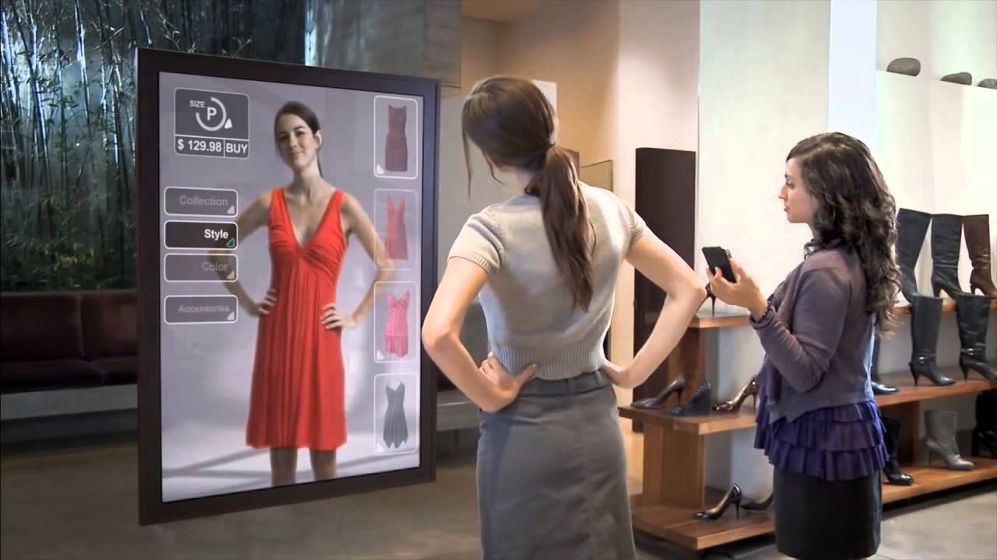
Near Future examples

Slide 16
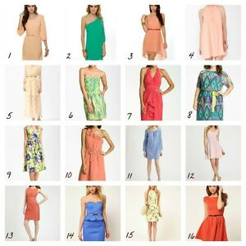
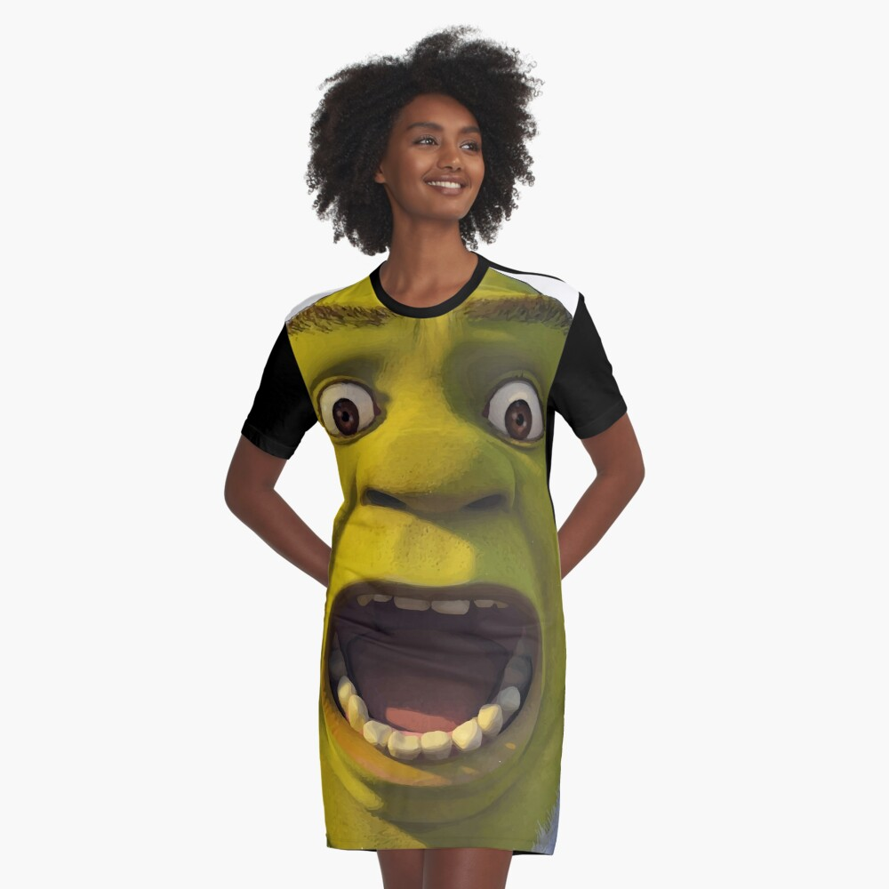
Machine Learning Pipeline
Labeled Data
Machine Learning Algorithm
Code /Math
Predictive Model
Amazon AI
Stitch Fix
Predictions (answers)
Don’t buy!
Unlabeled Data

Slide 17
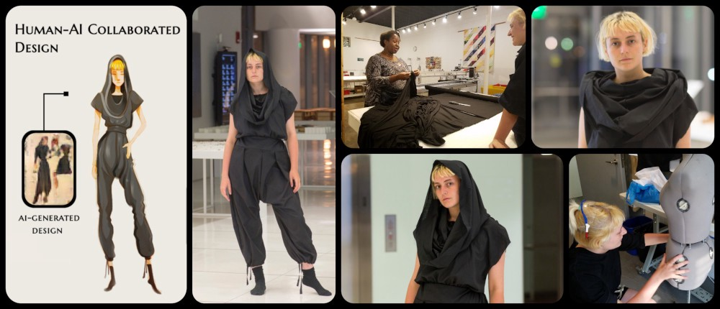
AI generated Design

Slide 18
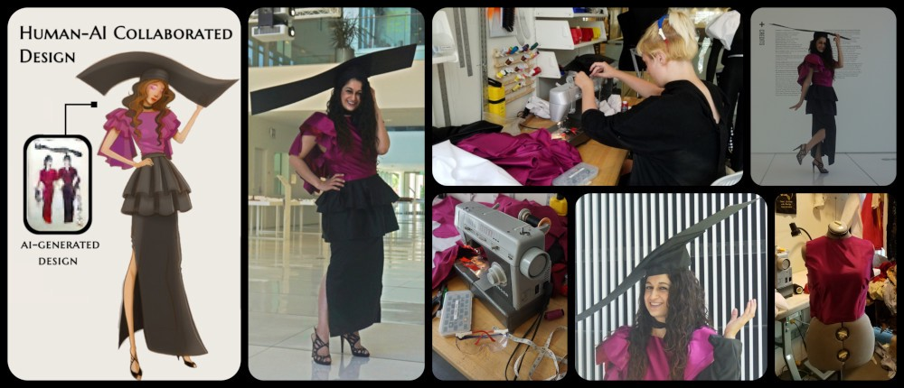
AI Generated Design (mistake?)

Slide 19
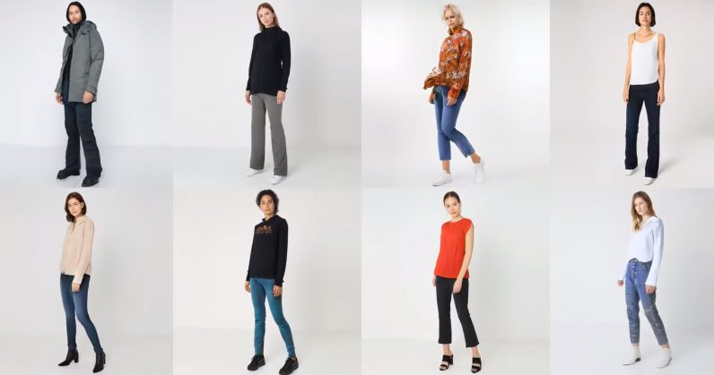
Fashion Modeling?

Slide 20
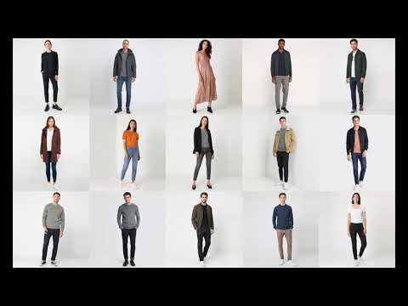

Slide 21
Use existing Data and Information
Where is my Market?
What do I look for in a product?
How to generate the more sales?
What makes a customer review the product positively?
Does the category of product change the expectations?

Slide 22
Marketing … where is my audience?
Is there a difference on which social media I advertise?
What products are better for Twitter?
What products are better for Facebook?
Twitter: https://fashionunited.com/i/twitter-fashion-index
Facebook: https://fashionunited.com/i/facebook-fashion-index

Slide 23
What do I look for in a product?
Let’s examine women’s shoes:
In small groups:
Load up 3 different shoes on Amazon
For each shoe:
Identify 5 different product details that might drive sales
Is there anything about the shoe that would indicate a trend?
Is there any domain (fashion) specific knowledge in the description
As a group: If you were to put up a new shoe for sale,
What indicators would you want to know to indicate a trend?
What features are most important to include to make a sale
Do those features differ from features that will make a customer leave a review?

Slide 24
Let’s see what data we can see
Spider and Crawlers:
Searches the web and extracts data
Can be made for any site with publically visible data

Slide 25
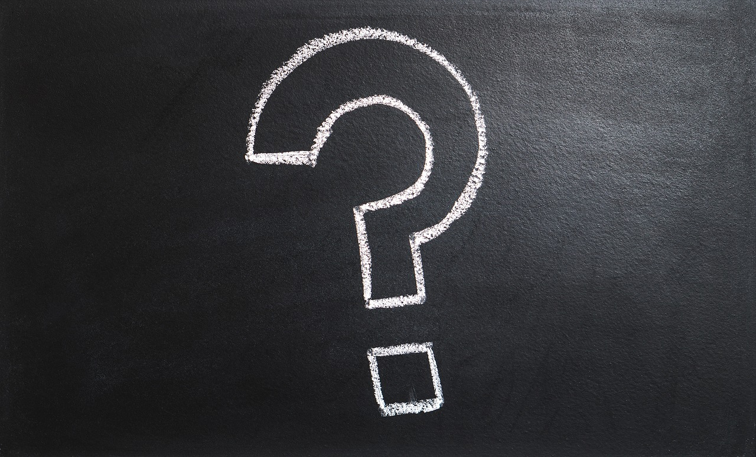
What other data would be useful?

Slide 26
Next year’s trends
What can we use from this data in order to assist our designs for the next year?

Slide 27
Problems with AI in Fashion?
Does it conceieve of a wardrobe?
If I liked one color of shoe, will I buy that color again?
How likely am I to purchase the same shoe type again?
What is the definition of simularity?
Do you change your look over time? (https://www.nytimes.com/2019/06/24/style/democratic-debate-candidates-image.html)

Slide 28
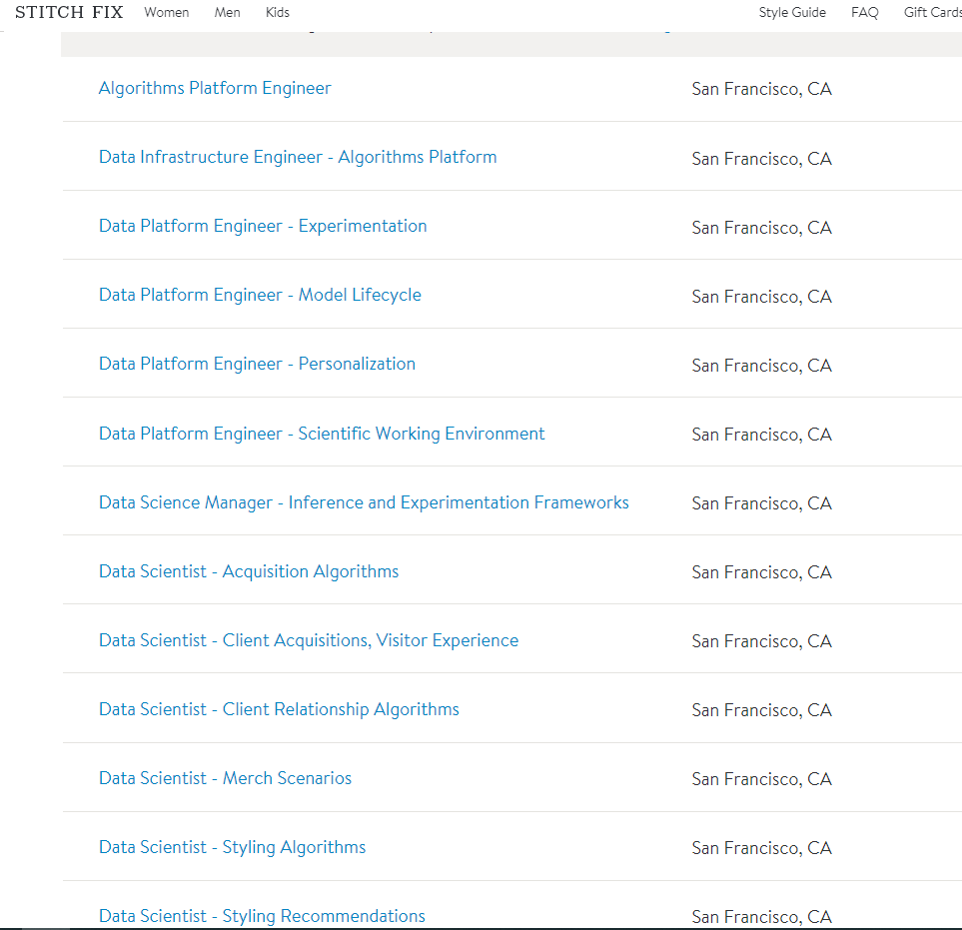
Jobs in the Domain:
Already exists but only growing
Domain knowledge is hard to come by

